Slide 1

ELL Leadership Academy
Karina E. Chapa, M.Ed.
Language Proficiency, Biliteracy
and Cultural Diversity Director
kchapa@esc1.net

Slide 2

Professional Learning Essential Agreements
Be respectful of others
Be an active participant
Take care of your needs
Use electronic devices as learning tools

Slide 3

Karina Elizabeth Zuno Cooley
https://www.mynamemyidentity.org
Karina E. Chapa
Small Group

Slide 4
Parking Lot Questions
What are you expecting to learn at this Academy?
Why are you interested in learning this?
What will you do with what you learn?

Slide 5
ELL leadership academy
Rationale

Slide 6
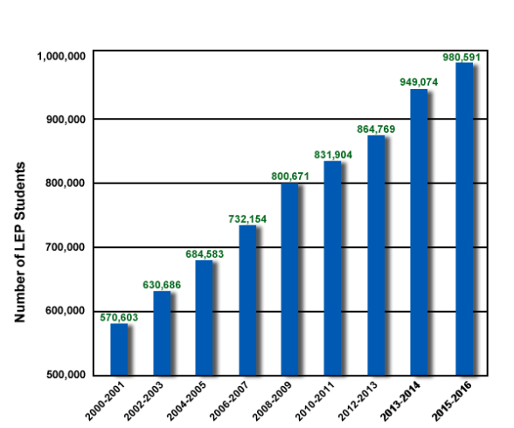
ELLs in Texas
160,000+
in Region One
Source: TEA, 2016

Slide 7
Changing Texas: 2050
Average Age
NHW 42
HW 28
Population
NHW 2%
HW 70%
Workforce
H vs NH
3:1
ECONOMIC
PRECIPICE
“In the absence of change, the Texas labor force as a whole will be less-educated, work in lower-status occupations, and have lower incomes in 2050 than 2010”
Steve Murdock, 2013

Slide 8
Changing Texas: 2050
Average Age
NHW 42
HW 28
Population
NHW 2%
HW 70%
Workforce
H vs NH
3:1
EDUCATION
FUTURE PROSPERITY
We are that CHANGE!

Slide 9
The Power of Region One
97% Hispanic
37% ELL PK-12
85% EcoDis
Region One TODAY
Texas in 30 Years

Slide 10
Tiered Professional Learning
Content
Teacher
Leader
System

Slide 11
The Role of the Leader
Successful ELL Program
Leadership Support
Quality Instructional Materials
Teacher Preparation
Carrasquillo and Rodriguez (1998) Measuring Success in Bilingual Education Programs: Case Studies of Exemplary Practices

Slide 12
The Role of the Leader
Low levels of ELL understanding
ELL Program Success
ELL Program Success
High levels of ELL understanding
Menkena and Solorzaba (2014) Principals as Linchpins in Bilingual Education: The Need for Prepared School Leaders.

Slide 13
Second Language Acquisition
LPAC-TELPAS-ELPS Connection
ELL Data Analysis and PEIMS Coding
ELL Subpopulations (SpEd, GT)
ELL State and Federal Accountability
Use of State and Federal Funds
TTESS/TPESS
Technology Integration
Making Thinking Visible Routines
Project-Based Learning

Slide 14
ELL Leadership Academy
Face to Face
Virtual Community
Possible Expansion
6 days/year
40+ hours
Book/Video Studies
Online Discussions
Virtual Academy
TOT State Level
Final Project
Lesson to Staff
Video
Peer Feedback
Once a six weeks
Texas Gateway

Slide 15
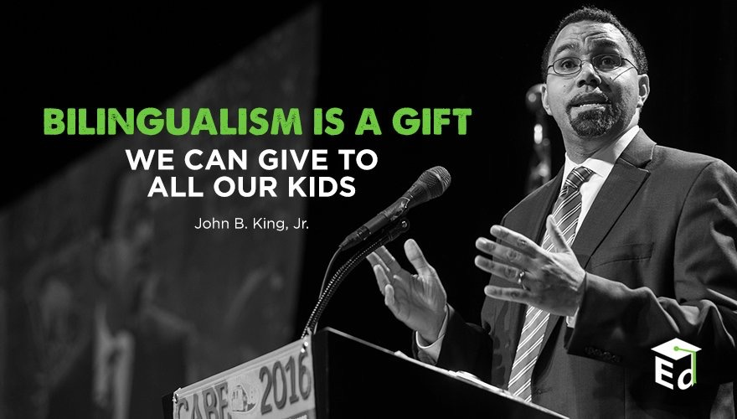
Second Language Acquisition
Notes:
45 mins

Slide 16
Session Objectives
Content Objective
Language Objective
Today I will analyze the second language acquisition process and understand its impact in the education of English Language Learners.
Today I will discuss with my peers the second language acquisition process and I will share orally and in writing my individual language profile.

Slide 17

SLA Anticipation Guide
Let’s
kahoot.it

Slide 18
Language Power
Cognitive
Social
Affective
“Language stands at the center of the many interdependent cognitive, affective, and social factors that shape learning”.
David Corson, 1999
LANGUAGE
=
IDENTITY
3-Step Interview

Slide 19
The Iceberg Theory
Basic Interpersonal Communication Skills
BICS
1-3 years
CALP
5-7 years
Cognitive Academic Language Proficiency
J. Cummins, 1981

Slide 20
Double Iceberg Theory
BICS L1 1-3 years
BICS L2 1-3 years
CALP L1+L2
5-7 years
J. Cummins, 1981

Slide 21
Transfer of Concepts
L1
L2
CALP
L1
L2
J. Cummins, 1981

Slide 22
In Other Words…
BICS L1
BICS L2
CALP
L1
L2
CALP Transfer L1-L2
J. Cummins, 1981

Slide 23
Research Findings
The stronger academically and cognitively the L1, the stronger the L2.
The weaker academically and cognitively the L1, the weaker the L2.
W. Thomas & V. Collier, 2009
Turn and Talk
Think-Pair-Share

Slide 24
My Language Profile
BICS Spanish
BICS English
CALP Spanish + English
1999

Slide 25
My Language Profile
BICS Spanish
BICS English
CALP Spanish + English
2017

Slide 26
Your Turn!
BICS L1
BICS L2
CALP L1+L2
Create your own language profile
Birthday Line
Notes:
90 mins

Slide 27

Edmodo Code: ktms9k
www.edmodo.com

Slide 28
Bilingual Program Models
Chapter 89, Jigsaw/Frayer Model
Bilingual Education
Remedial ( - )
Immersion
Early Exit
Enrichment (+)
Late Exit
Dual Language
One-Way
Two-Way

Slide 29
Frayer Model
Bilingual Program Models
Early Exit
Late Exit
One-Way DL
Two-Way DL

Slide 30
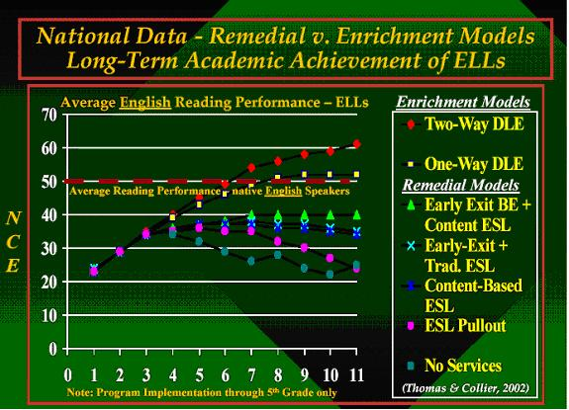
W. Thomas and V. Collier, 2002

Slide 31
English vs spanish
Phonology Awareness

Slide 32
Spanish vs English Phonology
Spanish
English
Based in syllables
mamá → ma-má
manzana → man-za-na
sol → sol
Based on phonemes
cat → /k/ /a/ /t/
bat → /b/ /a/ /t/
sat → /s/ /a/ /t/
rat → /r/ /a/ /t/

Slide 33
Spanish Phonology
FRONT
CENTER
BACK
iy (igual)
uw (uva)
HIGH
ε(ego)
ow (oso)
MEDIUM
a (al)
LOW

Slide 34
English Phonology
FRONT
CENTER
BACK
iy (meat)
I (mitt)
uw (pool)
Ư (pull)
HIGH
ey (mate) ε(met)
ə (mutt)
ow (coat)
MEDIUM
æ (mat)
a (pot)
o (caught)
LOW

Slide 35
Spanish vs English Phonology
English
Spanish
5 vowels = 11+ sounds
b / v = different sounds
You
bit / bite
bow / bow / vow
bath / bathe
5 vowels = 5 sounds
b / v = same sound
Tú / Usted
Closest sound to “th” in English is “d” in Spanish
It is raining→ Está lloviendo
Life is hard → La vida es dura

Slide 36


Slide 37
Common Mistakes
Adding an “e” before an “s”
school escuela specific específico
/skUl/ /es kue la/ /spəsi fic/ /es pe si fi co/
False cognates
exit → éxito (salida)
embarrased → embarazada (avergonzada)

Slide 38
The Power of Cognates
La chimica è la scienza che studia la composizione della materia ed il suo comportamento in base a tale composizione.

Slide 39
The Power of Cognates
La chimica è la scienza che studia la composizione della materia ed il suo comportamento in base a tale composizione.

Slide 40
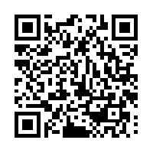
Your Turn!
1. Individually make a list of 5 academic words from any content area.
2. Turn to your partner and combine your two lists of words (even if from different content areas).
3. Find another pair and exchange your lists.
4. Write the Spanish cognates next to each academic word. Use Google Translate if needed.
5. Calculate what percentage of the words are cognates.
1 – 2 – 4 – ALL
http://www.realfastspanish.com/vocabulary/spanish-cognates

Slide 41

The Danger of a Single Story
https://www.youtube.com/watch?v=D4pH6TxKzus

Slide 42
Session Objectives
Content Objective
Language Objective
Today I analyzed the second language acquisition process and understood its impact in the education of English Language Learners.
Today I discussed with my peers the second language acquisition process and I shared orally and in writing my individual language profile.

Slide 43
Tickets Out
I used to think…
But now I know…

Slide 44
Thank you for your participation!
Karina E. Chapa, M.Ed.
Language Proficiency, Biliteracy and Cultural Diversity Director
kchapa@esc1.net
Facebook: Region One ESC Bilingual
Twitter @esc1bilingual @bilingualpride

